Slide 1
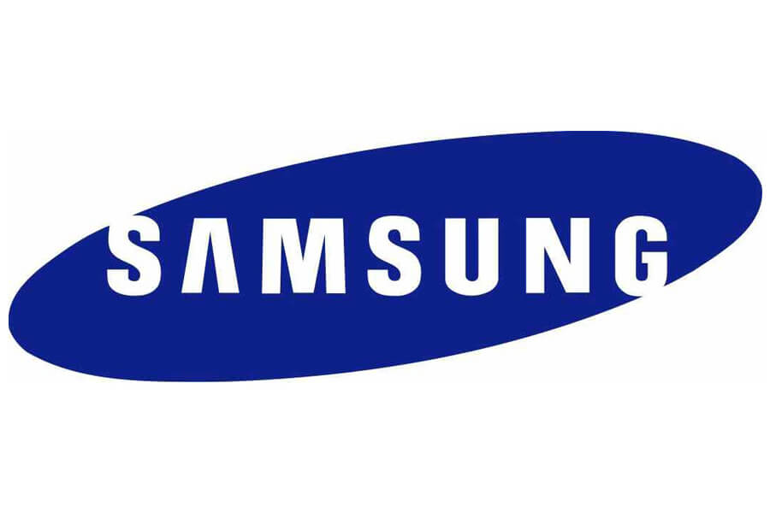
Samsung Group

Slide 2
Company Overview
Samsung Group was founded by Lee Byung-Chull in 1938.
It started as a grocery trading store and later ventured into textiles.
Protection of Korean local companies from foreign competition after the end of Korean War helped Samsung to expand its portfolio.
The company began venturing into electronics and digital products in 1969.
Large portfolio and large market share; company needed strategies to manage its employees, supply chain and customer experience; management information systems.
Notes:
Samsung was founded by Lee Byung-Chull on March 1, 1938, in Taegu in Korea. It started as a grocery trading store by exporting noodles and other goods produced in the city to China and its provinces. After Korean War, the firm enjoyed policies that were put by the Korean government aimed at shielding the local businesses from competition and providing easy financing at the same time. This gave the company a competitive advantage against its competitors and it quickly expanded into establishing new subsidiaries such as Samsung Shipbuilding, Samsung Heavy Industries, and Samsung Precision Company (Samsung Techwin).

Slide 3
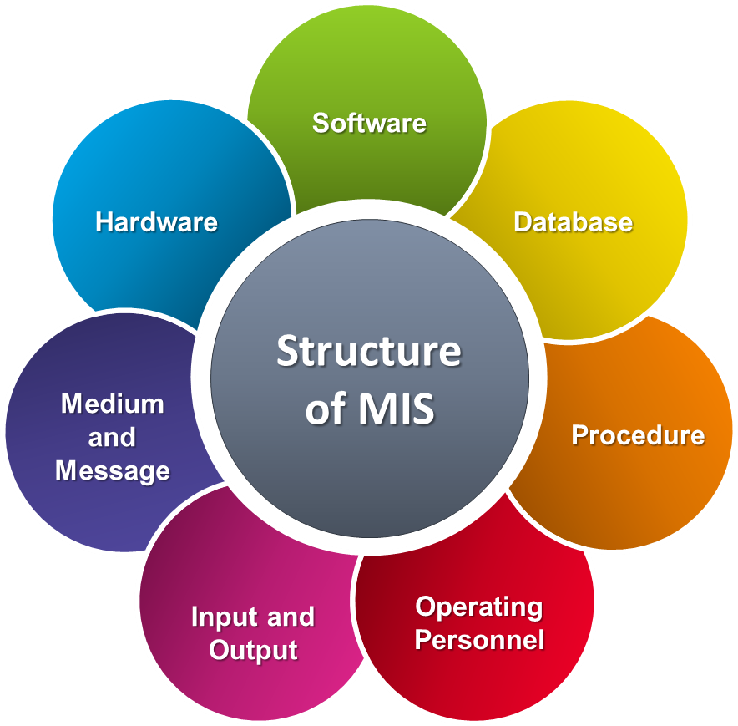
Implementation of Management Information System
Management Information System (MIS); use of information technology, people and processes to record and store data for managerial activities.
Provide accurate and timely information; for planning, decision-making, control, coordination.
Notes:
Management Information System (MIS) involves using information technology, people, and processes to record and store data for an organization’s managerial activities. It helps to provide accurate and timely information crucial in the planning, decision-making, control, coordination, and operational functions necessary for the effective running of an organization.

Slide 4
Implementation of MIS
A system that would quickly respond to the rapidly changing information technology-markets.
Samsung has implemented a supply chain management (SCM); a centralized supply control of its globally-spread divisions.
It allowed the firm to react fast to market changes, make market-driven decisions derived from strategic demand forecasts
The firm could make real-time deliveries of products.
Notes:
To edge out competitors, Samsung needed to develop a system that would quickly respond to the rapidly changing Information Technology-markets. Samsung has implemented a supply chain management (SCM); a centralized supply control of its globally-spread divisions. The adoption of supply chain management allowed the firm to react fast to market changes, make market-driven decisions derived from strategic demand forecasts, and standardized the information. This led to improved customer experience because the firm could make real-time deliveries of products.

Slide 5
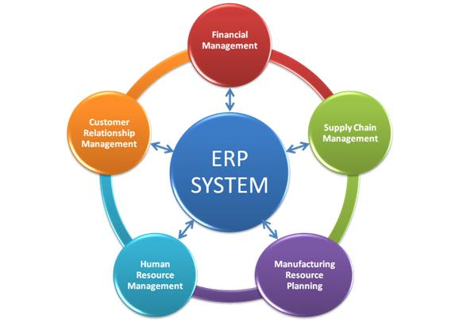
Implementation of MIS Cont…
Enterprise Resource Planning (ERP); gathering and organizing data to automate business functions such as production, accounting, and order management.
The daily operations are integrated into the ERP software.
ERP links information from various sources including, data warehouse, distribution, accounting, point of sale, and credit cards.
Notes:
Another management information system implemented by Samsung is Enterprise Resource Planning (ERP). This is a consolidated process of gathering and organizing data so that the business functions of production, accounting, and order management are automated. This means that the day-to-day business processes are integrated by software. This system connects information from all parts, including data warehouse, distribution, accounting, point of sale, and even credit card with one integrated interface.

Slide 6
Implementation of MIS Cont…
Samsung also implemented a strategy known as knowledge management; pass knowledge from one employee to another.
This transformed to Communication on Progress (Cop) program; phase of nurturing leaders through information exchange meetings.
The soon-to-retire employees would pass their knowledge and experiences to new employees.
This system has enabled Samsung to develop synergy by integrate work, innovation, and knowledge .
Notes:
Samsung also implemented a strategy known as knowledge management. Initially, this was started by a small group of employees to pass knowledge from one employee to another. This transformed to a Communication on Progress (Cop) program where leaders were being nurtured through through information exchange meetings. The soon-to-retire employees were tasked with the duty of passing their knowledge and experiences to new employees. Knowledge management has enabled Samsung to integrate its work, innovation, and knowledge into a synergy making the company a market leader.

Slide 7
SWOT Analysis for Samsung Group
Strengths, Weaknesses, Opportunities, and Threats facing any business enterprise.
Samsung’s strengths; investment in research and development.
Samsung has produced eco-innovations that are environmentally friendly.
Company’s brand; its quality products and significant innovations has placed it at a strategic position in the market.
Weaknesses; over-reliance on American Markets.
Opportunities; partnership with strategic software developers.
Notes:
One of Samsung’s strengths is its investment in research and development. Large amounts of resources are dedicated to innovative research. This has resulted in the firm producing a wide range of product portfolio that is high in quality. For several years now, Samsung has produced eco-innovations that are environmentally friendly. Another strength identified with Samsung is that it is an award-winning brand. The firm has strategically placed itself with significant innovations backed by credibility. Samsung’s weaknesses include over-reliance on American Markets. Although the firm has expanded its operations and diversified its resources to many parts of the world, the US market accounts for about 70% of the total sales. The overdependence can turn the tides of the firm in instances of recession.

Slide 8
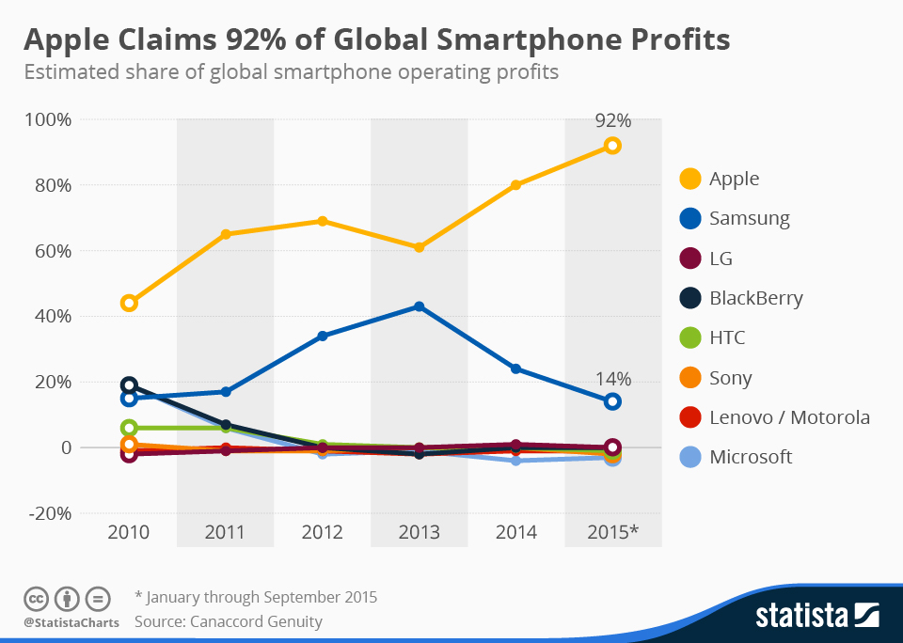
SWOT Analysis for Samsung Group Cont…
Threats of competitors and counterfeit products.
The firm’s products are among the most counterfeited products.
Government regulations and restrictions in various countries is also a threat to the firm’s operations.
Notes:
One of Samsung’s threats is stiff competition from rivals, including Apple, Huawei, Xiaomi, and others. Besides genuine competitors, Samsung faces a threat from counterfeit products. The firm’s products are among the most counterfeited products. Being a global producer, Samsung faces legal and regulatory threats from various countries where the firm operates. Government regulations and restrictions continue to be a hindrance to the firm’s operations. Economic uncertainty is another threat facing the Samsung group. Recession and a decline in demand for Samsung products are a significant threat to the firm.

Slide 9
Customer Relationship Management (CRM)
Samsung facilitates CRM by satisfying customers’ wants through quality improvement.
High-quality products ensure that customer needs are adequately met.
The firm’s stores allow customers to experience the products even if they were not to buy them.
The company develops different products targeting different customer segments.
Automation of customer support; Chatbots to improve synchronous customer engagement.
Notes:
Samsung facilitates CRM by satisfying customers’ wants through quality improvement. High-quality products ensure that customer needs are adequately met.
Besides, the firm strives to build long-term relationships through customer experiences. The firm’s stores allow customers to experience the products even if they were not to buy them. The employees at these stores ensure that every customer has a great and memorable experience at these stores. They also advise the customers how the products work and how they will enrich their lives. The customers are encouraged to touch and experience these products first-hand. Another customer relationship management strategy has been the development of different products targeting different customer segments. Another technique that has been put into practice is the automation of customer support. With the introduction of Chatbots, the firm can respond to customer concerns in real-time. This improves their engagement with their customers while at the same time, creating healthy relationships.

Slide 10
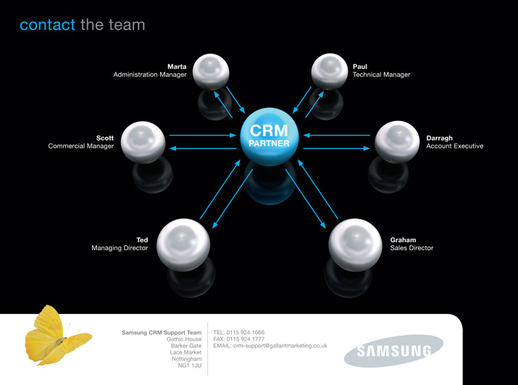
Notes:
Members of the CRM team at Samsung.

Slide 11
Information security at Samsung Group
Samsung Group has invested in an excellent back-up system for its information security.
The firm has also developed an intelligent security platform.
The security software collects, refines, analyses, and predicts the organization’s vulnerabilities and possible security threats.
Biometric authentication technology that allows the users to access information using ultrasonic fingerprint and face recognition.
Only the authorized personnel have access to private information.
Notes:
Samsung Group has invested in an excellent back-up system such that information is stored in at least two copies stored in different places. This ensures that the firm can quickly retrieve information lost through fires, accidents, or maliciously destroyed. For an information security guarantee, Samsung’s research has built an intelligent security platform to ensure that customer information is kept secure. It has also developed core security technologies to ensure complete security. The firm has also developed an intelligent security platform that collects, refines, analyses, and predicts the organization’s vulnerabilities and possible security threats. Additionally, the firm has invested in biometric authentication technology that allows the users to access the information using ultrasonic fingerprint and face recognition. This ensures that only the authorized personnel get access to the most private company information.

Slide 12
References
Ackerman, K. B. (2017). Fundamentals of supply chain management: An essential guide for 21st-century managers. DC Velocity Books.
AL-Zahawi, O. S. (2019). Information security handbook for ISO 27001 controls. UR academy.
Borucka, B. (2018). SWOT & SO WHAT? Make sense of your plans. Get to know how to build your business plan, undertake proper marketing decisions, and be more successful than others. Meet the SWOT analysis rediscovery. Exertus Group LTD.
Calicchio, S. (2020). SWOT analysis in 4 steps: How to use the SWOT matrix to make a difference in career and business. Stefano Calicchio.
Goyal, D. (2016). Management information systems: Managerial perspectives (4th ed.). Vikas Publishing House.
Hossain, L., Patrick, J., & Rashid, M. (2015). Enterprise resource planning: global opportunities and challenges: Global opportunities and challenges. IGI Global.
Michell, A. (2017). Samsung Electronics and the struggle for leadership of the electronics industry. John Wiley & Sons.
Shanthi, R. (2019). Customer relationship management. MJP Publisher.
Surhone, L. M., Timpledon, M. T., & Marseken, S. F. (2017). SWOT analysis. Beta script Publishing.

